Slide 1
New-Product Development Stages

Slide 2
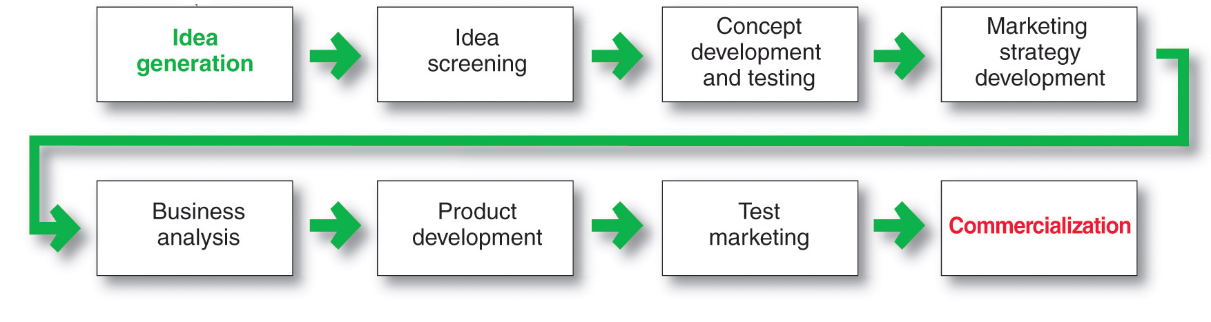
New-Product Development Process
Major Stages in New-Product Development

Slide 3

New-Product Development Process
Idea Generation
Idea generation is the systematic search for new-product ideas
Sources of new-product ideas
Internal
External
Notes:
Note to Instructor
Discussion Question
In groups of four come up with one ideas for a new products.
It might be helpful if you assign each group a category including kitchen products, office supplies, laptop accessories, dessert products, bathroom accessories, children’s toys, baby products, etc. Students will realize this is very difficult.

Slide 4

New-Product Development Process
Idea Generation
Internal sources refer to the company’s own formal research and development, management and staff, and intrapreneurial programs
External sources refer to sources outside the company such as customers, competitors, distributors, suppliers, and outside design firms
Notes:
Note to Instructor
It is not difficult to find examples of companies that are running contests where they ask consumers to send in ideas for new products. Dorito’s recently asked consumers to come up with a new flavor and new advertising. The Classic Mini Cooper brand was running Mini Mania’s the “Awesome New Product” Idea Contest. The grand prize winner received a 25 percent off promo code! Two second place winners will receive 15 percent off promo codes.

Slide 5
New-Product Development Process
Idea Screening
Identify good ideas and drop poor ideas
R-W-W Screening Framework:
  Is it real?
  Can we win?
  Is it worth doing?

Slide 6
New-Product Development Process
Concept Development and Testing
Product idea is an idea for a possible product that the company can see itself offering to the market
Product concept is a detailed version of the idea stated in meaningful consumer terms

Slide 7


New-Product Development Process
Concept Development and Testing
Concept testing refers to testing new-product concepts with groups of target consumers
Notes:
Note to Instructor
This Web link ties to a concept testing survey at Questionpro. It is helpful to point out to students that there are many online Web survey sites, which offer free surveys for market research. In this example, they supply a template for concept testing.

Slide 8
New-Product Development Process
Marketing Strategy Development
Marketing strategy development refers to the initial marketing strategy for introducing the product to the market
Marketing strategy statement includes:
  Description of the target market
  Value proposition
  Sales and profit goals

Slide 9
New-Product Development Process
Marketing Strategy Development
Business analysis involves a review of the sales, costs, and profit projections to find out whether they satisfy the company’s objectives

Slide 10

New-Product Development Process
Marketing Strategy Development
Product development involves the creation and testing of one or more physical versions by the R&D or engineering departments
Notes:
Note to Instructor
Many companies use their employees for product testing. Students might have worked at various consumer packaged goods companies, perhaps Quaker Oats, where they had to test cereal every day at lunch.
The text gives the example:
At Gillette, almost everyone gets involved in new-product testing. Every working day at Gillette, 200 volunteers from various departments come to work unshaven, troop to the second floor of the company’s gritty South Boston plant, and enter small booths with a sink and mirror. There they take instructions from technicians on the other side of a small window as to which razor, shaving cream, or aftershave to use. The volunteers evaluate razors for sharpness of blade, smoothness of glide, and ease of handling. In a nearby shower room, women perform the same ritual on their legs, underarms, and what the company delicately refers to as the “bikini area.” “We bleed so you’ll get a good shave at home,” says one Gillette employee.

Slide 11
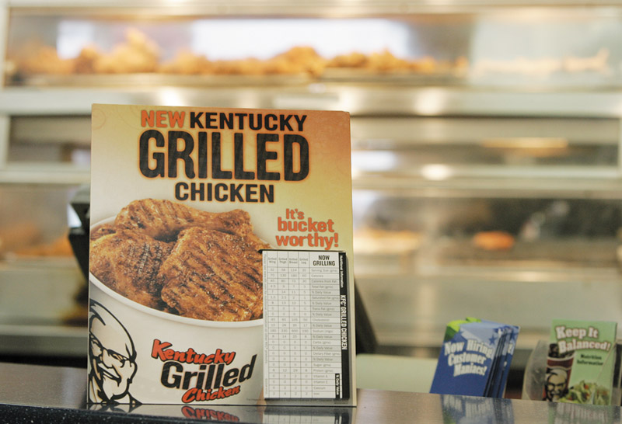
New-Product Development Process
Marketing Strategy Development
Test marketing is the stage at which the product and marketing program are introduced into more realistic marketing settings
Provides the marketer with experience in testing the product and entire marketing program before full introduction
Notes:
Note to Instructor
Here is a list of the top 10 test markets
1. ALBANY—SCHENECTADY—TROY, NY
2. ROCHESTER, NY
3. GREENSBORO—WINSTON—SALEM—-HIGH POINT, NC
4. BIRMINGHAM, AL
5. SYRACUSE, NY
6. CHARLOTTE—GASTONIA—ROCK HILL, NC/SC
7. NASHVILLE, TN
8. EUGENE—SPRINGFIELD, OR
9. WICHITA, KS
10. RICHMOND—PETERSBURG, VA
Source: Acxiom Corp., June 2004

Slide 12
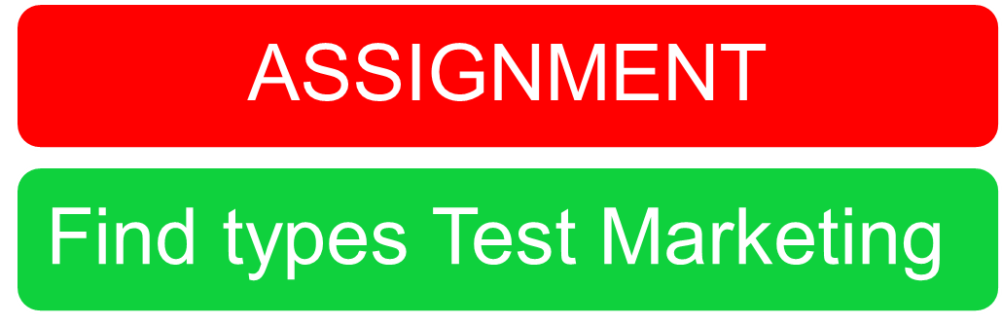
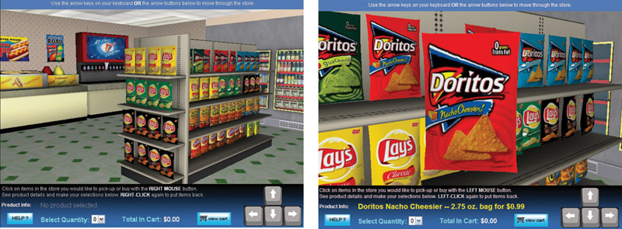
New-Product Development Process
Types of Test Markets

Slide 13

New-Product Development Process
Marketing Strategy Development
Commercialization is the introduction
of the new product
When to launch
Where to launch

Slide 14
Managing New-Product Development
Successful new-product development should be:
Customer centered
Team centered
Systematic

